Slide 1
Enterprise Software Life-cycle Support System
Software Factory NTI
Mike O’Brien, Toby Hable
June 2014

Slide 2
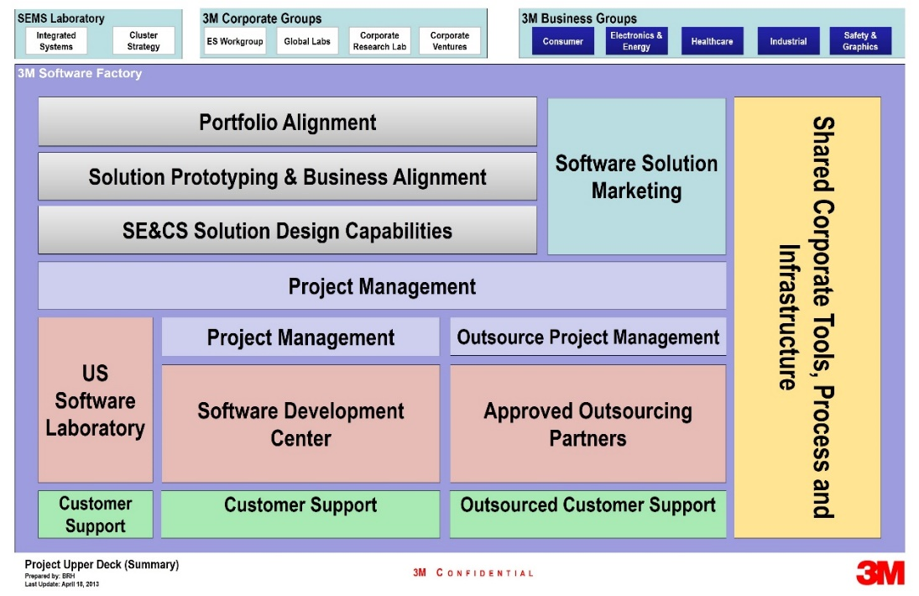
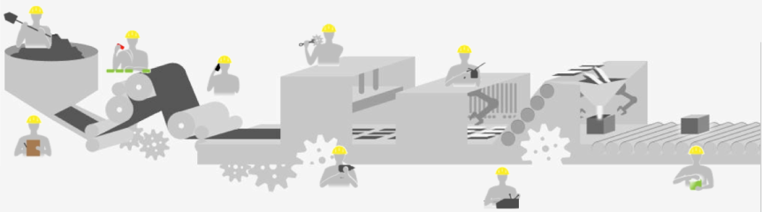











3M Software Factory – Software Engineering for the Future
Building the software engineering capabilities needed to enable rapid, high-quality and profitable product development.
Specialized Software Skillsets
Software Process Development
State of the Art Software Infrastructure
Divisions +
ES Workgroup

Slide 3
Software Life-cycle Support System – Enterprise Software Infrastructure
Idea
Concept
Feasibility
Dev’t
Scale Up
Launch
Post Launch
Division A
Software Process
Division B Software Process
Division C Software Process
Divisions establish software process based on business needs.
Software Life-cycle Support System (SLSS) using Microsoft TFS
NTI Goal
Notes:
current NPI process is high level
Implemented by divisions based on needs

Slide 4




Software Life-cycle Support System – Leveraging TFS
Tools
HISD Process
SEMS Process
Division Process …
Defined Processes
Application Lifecycle Management (ALM) System using Microsoft TFS
Process Template
TFS Technology
Platform
Project Management
Requirements Management
Version Control
Test Case Management
Build Automation
Reporting
Notes:
Team Foundation Server (TFS) is the collaboration platform at the core of Microsoft's application lifecycle management (ALM) solution. TFS supports agile development practices, multiple IDEs and platforms locally or in the cloud and gives you the tools you need to effectively manage software development projects throughout the application lifecycle.
TFS supports the defined process– both the enterprise development process, and division implementations

Slide 5
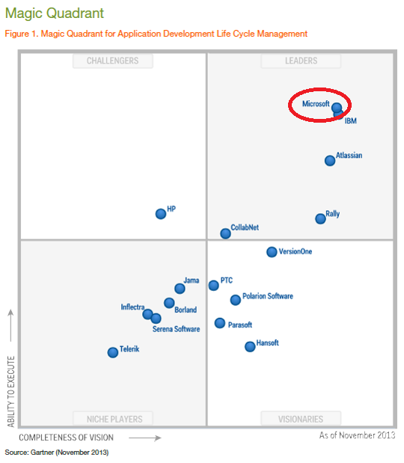






Why TFS?
Notes:
Magic Quadrant from TFS 2012
Large companies = US Bank, Target, Boeing, Dell, HP
TFS - market leader
In use widespread use within 3M
SEMS active user since 2006 – initial version of TFS
In use by other large companies for Enterprise wide use

Slide 6
Scalability
Scalability is the capability to increase resources to yield a linear (ideally) increase in service capacity
Achievable with:
  Well defined and adopted process
  Common tools
  Similar skillsets across teams
Process / Optimization
Project Management
Requirements Management
Design & Architecture
Development
QA & Test
Release Management
Software Development Process

Slide 7
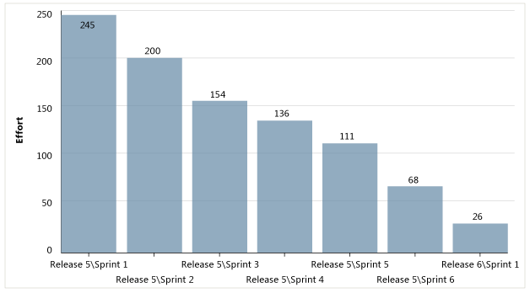
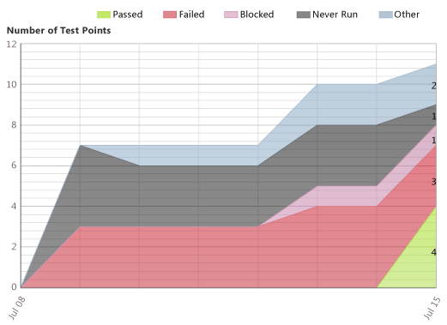
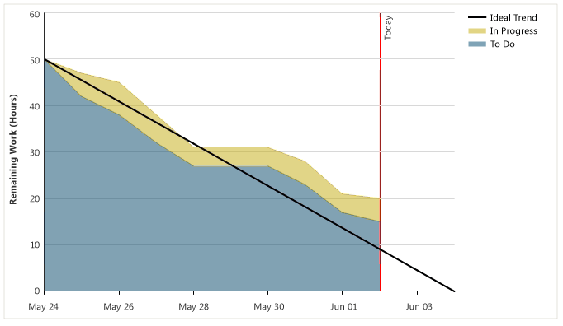
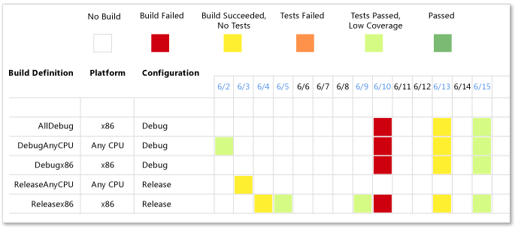
Software Development Scalability in ETFS
Process / Optimization
Project Management
Requirements Management
Design & Architecture
Development
QA & Test
Release Management
Tracking the Release
Status of Testing
Software Development Process
Quality of Work
Work per Iteration

Slide 8
Cost / ROI
Setup and Installation
  Infrastructure Planning and Validation
  Team Onboarding
  Governance
Cost: $250K
Team Onboarding and Operational Support
5 resources to:
  Provide Training
  Migrate Team to ETFS
  Enhance ETFS Service offering
  Support and Maintenance Operations
Cost: $ TBD (annually)

Slide 9
Who
Relationship Manager
Work with teams to adopt and embrace TFS
(1 Resource)
Solutions Team
Integrate tools to support specific environments
(2 Resources)
Operations
Single point of customer support
(2 Resources)

